Slide 1
Discrete-Time Fourier Transform (DTFT)
Signals and Systems Fall 2020
Prof. Adnan Kavak
Computer Engineering
Kocaeli University
This slides are prepared by Nabat Hengeldiyova based on Lecture Notes of Prof.A.Kavak

Slide 2

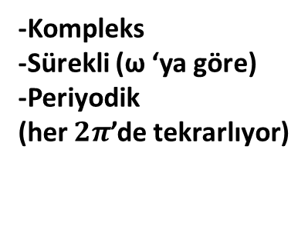
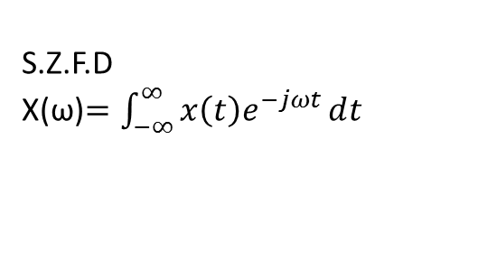


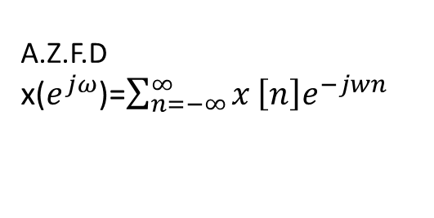
Ayrık Zamanda Fourier Dönüşümü
Sürekli Zaman
x(t)
S.Z.F.D
X(ω)$=\int_{−∞}^{∞}{x\left(t\right)ⅇ^{−jωt}ⅆt}$
F
-Kompleks
-Sürekli (ω ‘ya göre)
-Periyodik değil
0
t
0
t
A.Z.F.D
x($ⅇ^{jω}$)=$\sum_{n=−∞}^{∞}{x}\left[n\right]ⅇ^{−jwn}$
-Kompleks
-Sürekli (ω ‘ya göre)
-Periyodik
(her $2π$’de tekrarlıyor)
Ayrık Zaman
x[n]
F
$$−2π$$
0
$$2π$$
0
n
$$4π$$

Slide 3

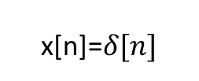

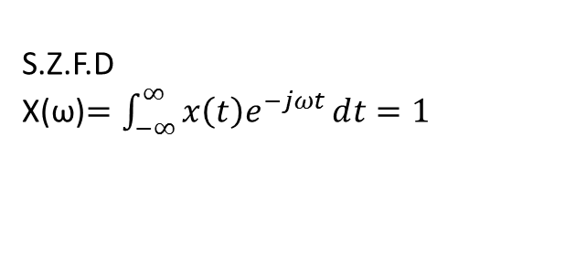

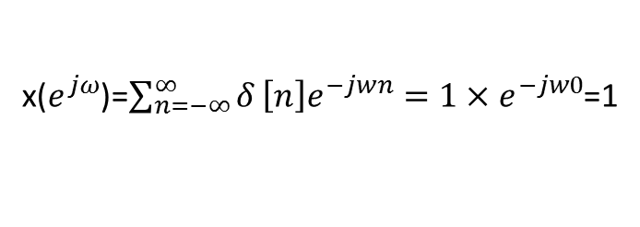
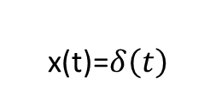

Example 1
x(t)=$δ\left(t\right)$
S.Z.F.D
X(ω)$=\int_{−∞}^{∞}{x\left(t\right)ⅇ^{−jωt}ⅆt=1}$
F
1
t=0
0
0
t
t
0
ω
x[n]=$δ[n]$
x($ⅇ^{jω}$)=$\sum_{n=−∞}^{∞}{δ}\left[n\right]ⅇ^{−jwn}=1×ⅇ^{−jw0}$=1
x($ⅇ^{jω}$)
F
1
0
n
$$−π$$
0
$$π$$
ω
$$−π≤ω<π$$

Slide 4

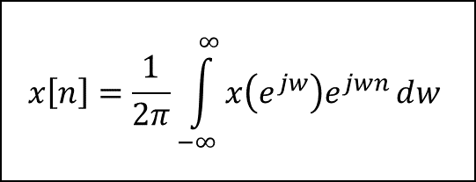

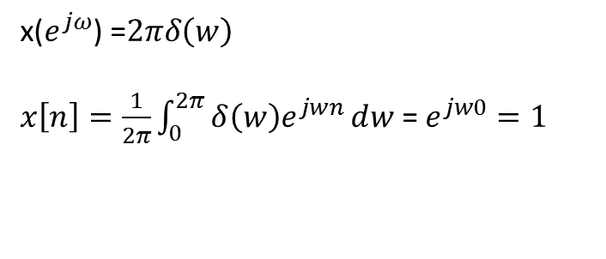




Sentez (Ters Dönüşüm) Denklemi Example 2
x($ⅇ^{jω}$) =$2πδ\left(w\right)$
$x\left[n\right]=\frac{1}{2π}\int_{0}^{2π}{δ\left(w\right)ⅇ^{jwn}ⅆw }$= $ⅇ^{jw0}=1$
$$x\left[n\right]=\frac{1}{2π}\int_{−∞}^{∞}{x\left(ⅇ^{jw}\right)ⅇ^{jwn}ⅆw}$$
ω =0
x($ⅇ^{jω}$)
$$F^{−1}$$
x[n]
$$2πδ\left(w\right)$$
1
F
0
$$π$$
ω
-3
-2
-1
0
1
2
3
4
5
n
$$−π$$
$$0≤ω<2π$$

Slide 5


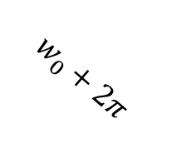


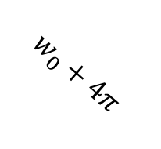
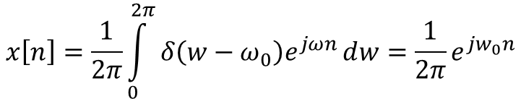


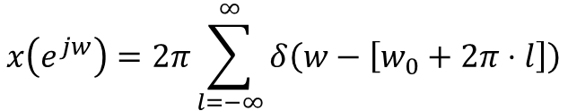







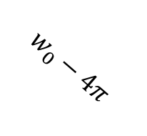





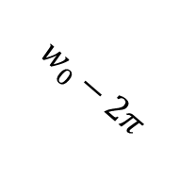

Example 3
x($ⅇ^{jω}$)=$\left\{\begin{matrix}δ\left(ω−ω_{0}\right) 0≤ω<2π \end{matrix}\right.$
$$x\left[n\right]=\frac{1}{2π}\int_{0}^{2π}{δ\left(w−ω_{0}\right)ⅇ^{jωn}ⅆw}=\frac{1}{2π}ⅇ^{jw_{0}n}$$
$$w=ω_{0}$$
$$ω_{0}−2π$$
0
$$ω_{0}$$
$$2π$$
$$x\left[n\right]=e^{jω_{0}n}$$
$$2πδ\left(w−w_{0}\right) 0≤ω<2π$$
$$ω_{0}+2π$$
$$1$$
$$F$$
$$F^{−1}$$
$$2πδ\left(w\right)$$
$$1⋅ⅇ^{jωn}$$
$$F$$
$2πδ\left(ω−w_{0}\right)$ $0≤ω<2π$
x[n]${=e}^{jω_{0}n}$
2$π$
$$x\left(e^{jw}\right)=2π\sum_{l=−∞}^{∞}{δ\left(w−\left[w_{0}+2π⋅l\right]\right)}$$
$$F^{−1}$$
x[n]${=e}^{jω_{0}n}$
0
n
$$w_{0}$$
$$w_{0}−2π$$
$$w_{0}+4π$$
$$w_{0}−4π$$
$$w_{0}+2π$$

Slide 6




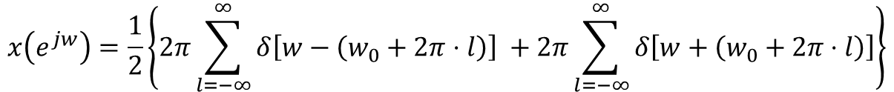



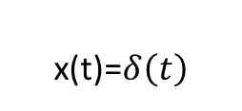



Example 4
$$x\left[n\right]=\cos\left[w_{0}n\right]$$
x(t)=$δ\left(t\right)$
0
$$T_{o}$$
n
$$−2π$$
$$−π$$
$−ω_{0}$
0
$$w_{0}$$
t
$$π$$
$$2π$$
t
$$w_{0}=2πf_{0}=2π_{\frac{1}{T_{0}}}$$
F
$$x\left(ⅇ^{jw}\right)=\frac{1}{2}\left\{2π\sum_{l=−∞}^{∞}{δ\left[w−\left(w_{0}+2π⋅l\right)\right]} +2π\sum_{l=−∞}^{∞}{δ\left[w+\left(w_{0}+2π⋅l\right)\right]}\right\}$$
x$\left[n\right]=\frac{1}{2}\left(ⅇ^{jω_{0}n}+ⅇ^{−jω_{0}n}\right)$
$$l=0 −π≤w≤π$$
$$x\left(ⅇ^{jw}\right)=πδ\left(ω−ω_{0}\right)+πδ\left(w+w_{0}\right)$$

Slide 7


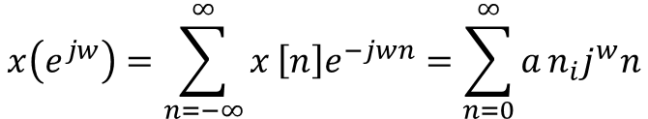
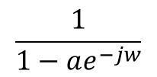









Example 5
$$\frac{1}{2}$$
$x\left[n\right]=a^{n}u\left[n\right]$ $a=\frac{1}{2} için$
$$a∈ⅇ \left|a\right|<1 azalan$$
$$x\left(ⅇ^{jw}\right)=\sum_{n=−∞}^{∞}{x}\left[n\right]ⅇ^{−jwn}=\sum_{n=0}^{∞}{a}n_{i}j^{w}n$$
=$\sum_{n=0}^{∞}{{\left(aⅇ^{−jw}\right)}^{n}}=\frac{1}{1−ae^{−jw}}$
0
n
$$r=aⅇ^{−jω}$$
$$0≤ω<2π$$
$$\left|r\right|<1$$
$$S=1+r+r^{2}+…+r^{N−1}+r^{N}$$
$$S r=1+r+r^{2}+r^{3+}…+r^{N}+r^{N+1}$$
$S$-$S_{}r=1−r^{N+1}$
$$s=\frac{1−r^{N+1}}{1−r}$$
$$\sum_{n=0}^{∞}{r^{n}}=\lim_{N→∞}S=\lim{\frac{1−r^{N+1}}{1−r}}=\left\{\begin{aligned}\frac{1}{1−r} \left|r\right|<1 \\ ∞ \left|r\right|>1\end{aligned}\right\}$$
F
$$\frac{1}{1−ae^{−jw}}$$
$$x\left[n\right]=a^{n}u\left[n\right]$$
$\left|x\left(ⅇ^{jw}\right)\right|= \frac{1}{|1−ae^{−jw}|}$ = $\frac{1}{\left|1−\left[\cos{ω}−ja⋅\sin{ω}\right]\right|}$
$=\frac{1}{\sqrt{{\left(1−a\cos{ω}\right)}^{2}+a^{2}\sin^{2}{w}}}$ = $\frac{1}{\sqrt{1−2a\cos{w}+a^{2}\cos^{2}{ω}+a^{2}\sin^{2}{w}}}$
$x\left(ⅇ^{jw}\right)$ $=\frac{1}{\sqrt{1−2a\cos{w}+a^{2}}}$
$$a^{2}$$
$$0≤ω<2π$$

Slide 8
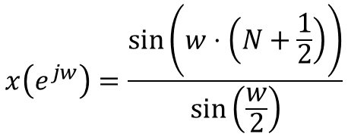

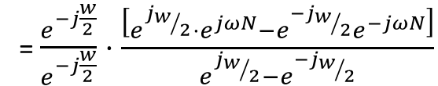
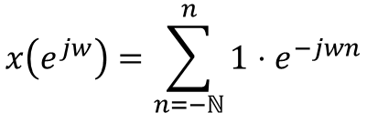


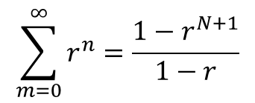

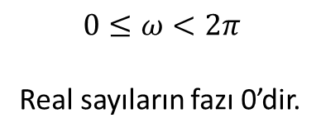
Example 6
x[n]
F
Tahmin
-N
0
N
0
t
n
$$x\left(ⅇ^{jw}\right)=\sum_{n=−ℕ}^{n}{1}⋅ⅇ^{−jwn}$$
$$\sum_{m=0}^{∞}{r^{n}}=\frac{1−r^{N+1}}{1−r}$$
$$m=n+N$$
$$n=m−N$$
=$\sum_{m=0}^{2N}{ⅇ^{jw\left(m−N\right)}}={ ⅇ}^{jwn}\sum_{m=0}^{2N}{ⅇ^{−jwn}}$
$${=ⅇ}^{jwn}\frac{1−ⅇ^{−jm\left(2N+1\right)}}{1−ⅇ^{−jw}}$$
= $\frac{ⅇ^{jwN}−ⅇ^{−jw}}{1−ⅇ^{−jw}}$
= $\frac{e^{−j\frac{w}{2}}}{e^{−j\frac{w}{2}}}⋅\frac{\left[ⅇ^{j_{w/2}}⋅ⅇ^{jωN}−ⅇ^{{−j}_{w/2}}ⅇ^{−jωN}\right]}{ⅇ^{j_{w/2}}−ⅇ^{{−j}_{w/2}}}$
$$x\left(ⅇ^{jw}\right)=\frac{\sin\left(w⋅\left(N+\frac{1}{2}\right)\right)}{\sin\left(\frac{w}{2}\right)}$$
$$0≤ω<2π$$
Real sayıların fazı 0’dir.

Slide 9








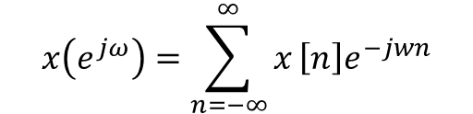

A.Z.F.D Özellikleri
1.Periyodiklik
F
$$x\left(ⅇ^{jω}\right)=\sum_{n=−∞}^{∞}{x}\left[n\right]ⅇ^{−jwn}$$
$$x\left[n\right]$$
$$x\left(ⅇ^{jω}\right)$$
$$2π ile periyodiktir$$
2.Lineerlik
F
$$x_{1}\left[n\right]$$
$${ x}_{1}\left(ⅇ^{jw}\right)$$
$$x_{2}\left[n\right]$$
F
$${ x}_{2}\left(ⅇ^{jw}\right)$$
$$ax_{1}\left[n\right]+bx_{2}\left[n\right]$$
F
$$ax_{1}\left(ⅇ^{jw}\right)+bx_{2}\left(ⅇ^{jw}\right)$$

Slide 10





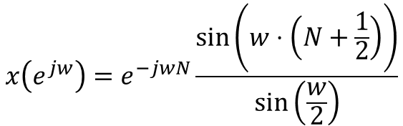
A.Z.F.D Özellikleri
3.Zamanda Öteleme
x[n]
$$x\left[n−n_{0}\right]$$
F
$$ⅇ^{−jwn_{0}}X\left(ⅇ^{jω}\right)$$
Örnek 6’daki sinyali N birim ötelersek
0
n
2N
$$x\left(ⅇ^{jw}\right)=ⅇ^{−jwN}\frac{\sin\left(w⋅\left(N+\frac{1}{2}\right)\right)}{\sin\left(\frac{w}{2}\right)}$$
$$0≤ω<2π$$
4.Frekansta Öteleme
$$ⅇ^{Jω_{0}n}x\left[n\right]$$
F
X$\left(ⅇ^{j\left(w−w_{0}\right)}\right)$

Slide 11

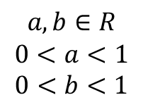












A.Z.F.D Özellikleri
5.Zamanda Ters Çevirme
$$x\left[n\right]$$
F
$$×\left(ⅇ^{jw}\right)$$
$$x\left[−n\right]$$
F
Pozitif değer negatif yapılır
Example
$$x^{∗}\left(e^{jw}\right)$$
6.Zamanda Konvolusyon
$$x\left[n\right]=a^{n}u\left[n\right]$$
$$a,b∈R$$
$$0<a<1$$
$$0<b<1$$
y$\left[n\right]$
$$x\left[n\right]=b^{n}u\left[n\right]$$
$$x\left[n\right]$$
h$\left[n\right]$
$$y\left[n\right]=x\left[n\right]∗h\left[n\right]$$
$$y\left(ⅇ^{jw}\right)=x\left(ⅇ^{jω}\right)⋅H\left(ⅇ^{jw}\right)$$
$$y\left[n\right]=x\left[n\right]∗h\left[n\right]$$
F
$$y\left(e^{jw}\right)=x\left(ⅇ^{jw}\right)⋅H\left(ⅇ^{jw}\right)$$
$x\left(ⅇ^{jw}\right)= \frac{1}{|1−ae^{−jw}|}. \frac{1}{|1−be^{−jw}|}$

Slide 12


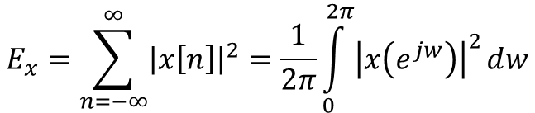


A.Z.F.D Özellikleri
7.Frekansta Türev Alma
$$x\left[n\right]$$
F
$$×\left(ⅇ^{jw}\right)$$
F
$$j\frac{ⅆX\left(ⅇ^{jω}\right)}{ⅆw}$$
$$nx\left[n\right]$$
8.Sinyal Enerjisi
$$E_{x}=\sum_{n=−∞}^{∞}{{\left|x\left[n\right]\right|}^{2}}=\frac{1}{2π}\int_{0}^{2π}{{\left|x\left(ⅇ^{jw}\right)\right|}^{2}ⅆw}$$
Parseval ilişkisi

Slide 13
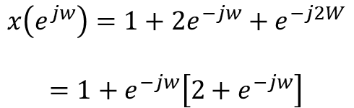
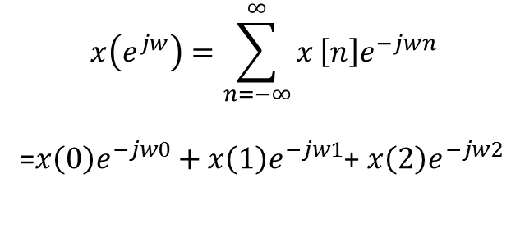

Example 7
x[n]
$$x\left(ⅇ^{jw}\right)=\sum_{n=−∞}^{∞}{x}\left[n\right]ⅇ^{−jwn}$$
=$x\left(0\right)ⅇ^{−jw0}+$ $x\left(1\right)ⅇ^{−jw1}$+ $x\left(2\right)ⅇ^{−jw2}$
2
1
1
0
1
2
n
$$x\left(ⅇ^{jw}\right)=1+2ⅇ^{−jw}+ⅇ^{−j2W}$$
$$=1+e^{−jw}\left[2+ⅇ^{−jw}\right]$$
Ödev
x[n]
2
1
1
$$x\left(ⅇ^{jw}\right)= ?$$
-1
0
1
n

